Slide 1
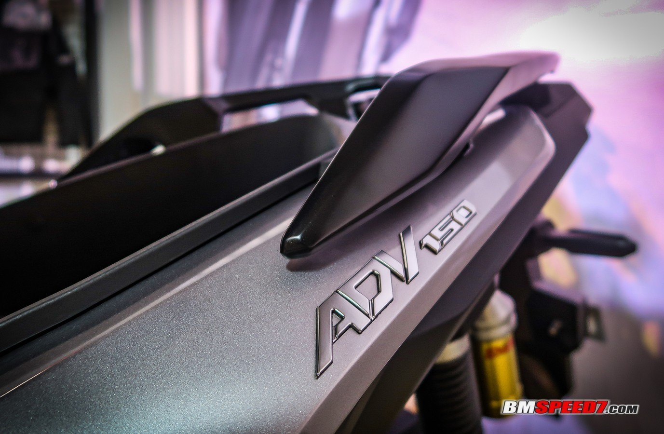

PT. GRAFINDO
MITRASEMESTA
COMPANY PROFILE / 2026
OEM automotive
graphics & emblems
Graphic & Label / Resin Dome / Soft Emblem
ESTABLISHED 1994
CIKARANG, INDONESIA
Notes:
Source: original Grafindo ComPro 2026, slide(s) 1.
Opening company profile. The product photo is from the original deck, slide 19.

Slide 2
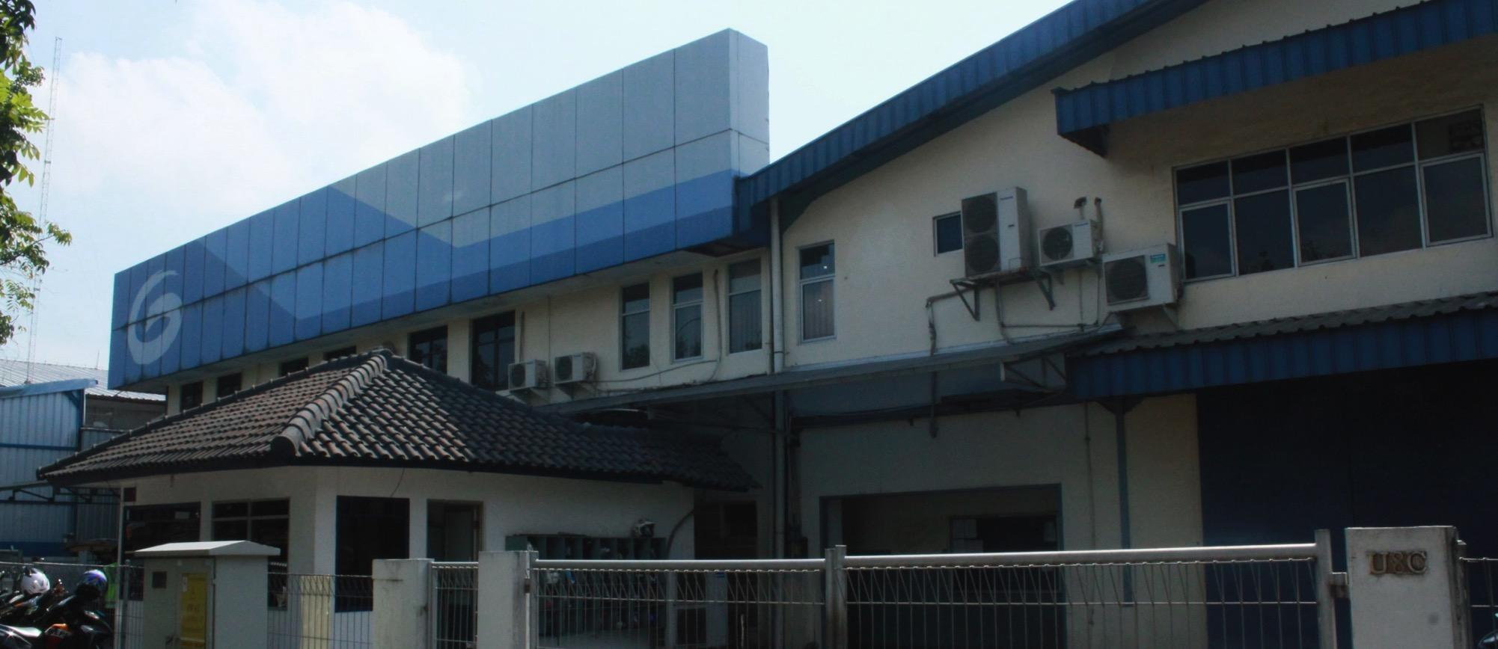
COMPANY
Grafindo at a glance
OEM automotive graphics • Established in 1994
1994
250
100%
Established
Employees
Local ownership
FACILITIES
Land
Office
4,130 m²
820 m²
Factory 1
Factory 2
BUSINESS LINE
2,828 m²
1,000 m²
OEM automotive
graphics
GRAFINDO / COMPANY PROFILE 2026
COMPANY
02
Notes:
Source: original Grafindo ComPro 2026, slide(s) 2.

Slide 3
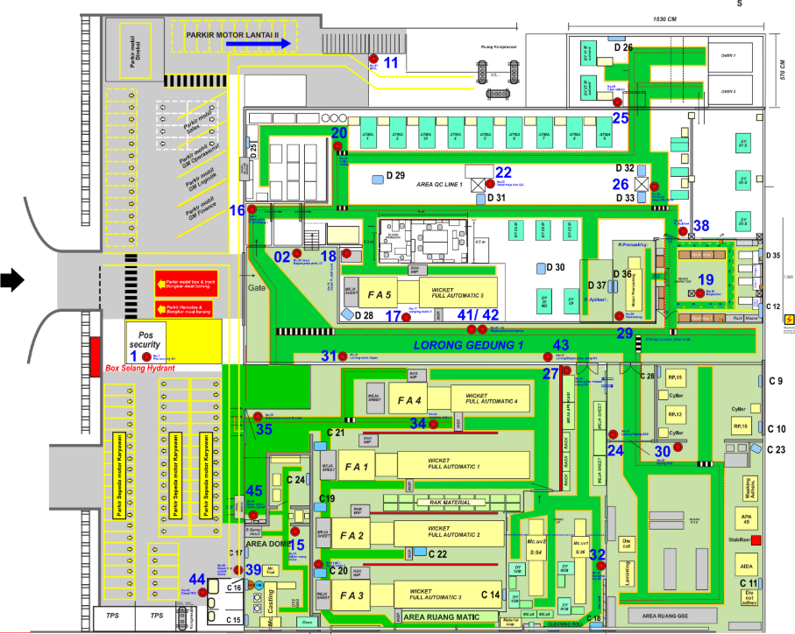
FACILITIES
U8C/D · Floor 1
Production facility
FUNCTIONAL AREAS
01
Printing
Full automatic printing areas
02
Quality control
QC line and inspection zones
03
Dome & GSE
Dedicated production areas
04
Ink mixing
Material preparation area
GRAFINDO / COMPANY PROFILE 2026
FACILITIES
03
Notes:
Source: original Grafindo ComPro 2026, slide(s) 3.
Facility plan reproduced from the source without changing the physical arrangement. Original Indonesian floor labels: Lantai 1 / Lantai 2.

Slide 4
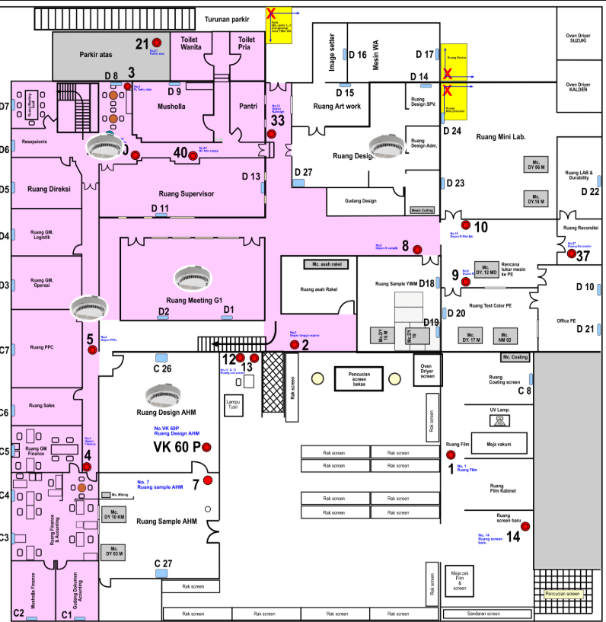
FACILITIES
U8C/D · Floor 2
Development, testing & offices
FUNCTIONAL AREAS
MUSHOLLA
01
Design & artwork
Design, film and screen preparation
02
Sample development
Customer sample areas
03
Laboratory
Testing and durability areas
04
Office & meetings
Administrative and meeting rooms
GRAFINDO / COMPANY PROFILE 2026
FACILITIES
04
Notes:
Source: original Grafindo ComPro 2026, slide(s) 3.
Facility plan reproduced from the source without changing the physical arrangement. Original Indonesian floor labels: Lantai 1 / Lantai 2.

Slide 5
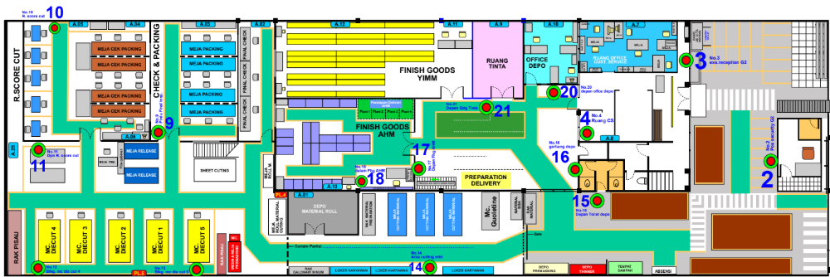
FACILITIES
U7A · Finishing & logistics
Die-cutting, inspection, finished goods and delivery preparation
01
Die-cutting
02
Packing & checks
03
Finished goods
04
Delivery preparation
GRAFINDO / COMPANY PROFILE 2026
FACILITIES
05
Notes:
Source: original Grafindo ComPro 2026, slide(s) 4.

Slide 6
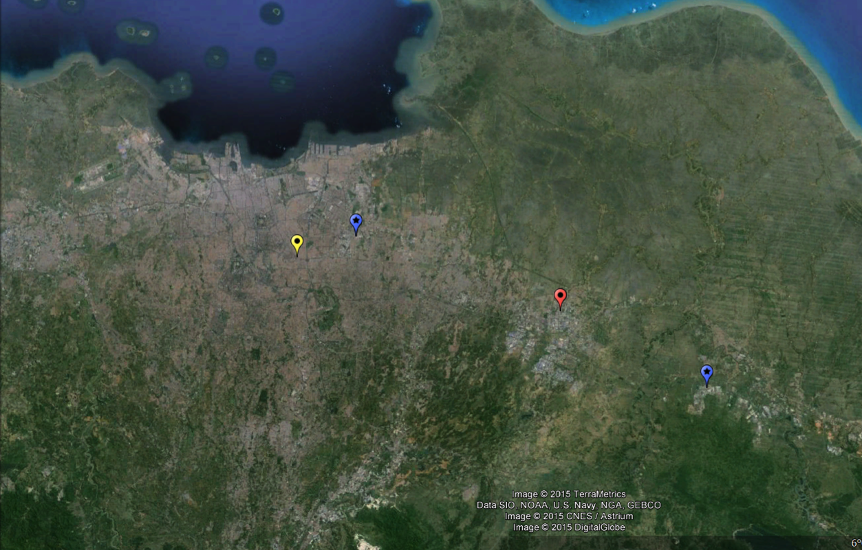
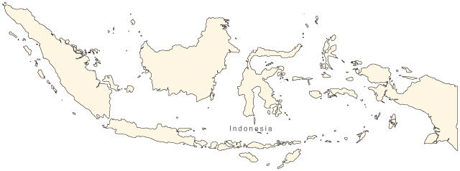
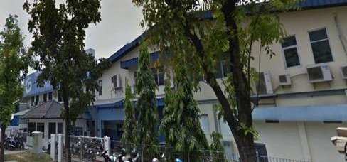
LOCATION
Connected to West Java’s industrial corridor
Head office & workshop • Cikarang, Bekasi, Indonesia
INDONESIA
Pulogadung
JAKARTA
GRAFINDO
Cikarang
Karawang
Jababeka I
Blocks U8D, U8C & U7A
Cikarang • Bekasi
GRAFINDO / COMPANY PROFILE 2026
LOCATION
06
Notes:
Source: original Grafindo ComPro 2026, slide(s) 5.
Click 1 reveals the Cikarang map and geographic callouts. Click 2 reveals the facility photo and site address. The fade preset comes from the original slide.

Slide 7
ORGANIZATION
Leadership & organization
Organizational structure • 2026
DIRECTOR
H. Garry Tisnantono
GM Finance & Accounting
GM Operational
Jr. GM Business Development
& Quality Technology
GM Admin & General Affairs
Koko Udoyo
H. Subagiyo
M. Benz Kautsar
H. Moersid Zaenal
Finance
Sales
Six departmental teams
Administration & general affairs
Asmen Finance · Ferdi
Spv. Accounting · Heni
Sales · Riyono
Development · Production · Quality
HRD & GA · Logistics · GSE
GRAFINDO / COMPANY PROFILE 2026
ORGANIZATION
07
Notes:
Source: original Grafindo ComPro 2026, slide(s) 6.
Source organization chart dated Cikarang, 7 January 2026. Solid lines show the direct links displayed in the source. Dotted lines indicate the source coordination links between operational, business/quality, and administration roles. The six departmental teams are expanded on the next slide. Source role GM Admin & Umum translated to General Affairs.

Slide 8
ORGANIZATION
Department organization
Business Development & Quality Technology • M. Benz Kautsar
ASMEN DEVELOPMENT
ASMEN PRODUCTION
ASMEN QUALITY
ASMEN HRD & GA
ASMEN LOGISTICS
ASMEN GSE
Rasyidin
Eko. S
Surono
Ismanto
Sopian H
Yasim
Spv. PE & Expose
Spv. Printing
Spv. QC
Spv. GA & ISO
Spv. Inv. Control
Soft Emblem
Anton S
Muslikin
M. Diaelani
Nur Misbah
Sukamto
Budi U
Spv. Tech. Support
Spv. Finishing
Spv. QA
Spv. HRD
CS
Agus
Koko B
Dicky
Esti Waluyanti
Sanas
Color Mixing
Spv. Dome
Spv. Purchasing
Sofian / Suhendar
Yulianto
Andry
Design
Sparepart
Amar
Rakijan
Spv. PPC
Aristur W
GRAFINDO / COMPANY PROFILE 2026
ORGANIZATION
08
Notes:
Source: original Grafindo ComPro 2026, slide(s) 6.
Editable transcription of all six departmental branches in the source organization chart. Role abbreviations and employee names are retained from the image. Finance, Accounting and Sales reporting are shown on the leadership slide.

Slide 9
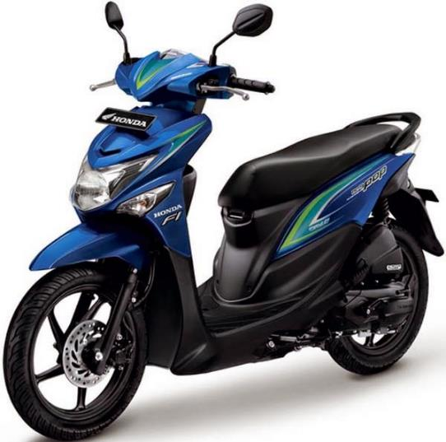
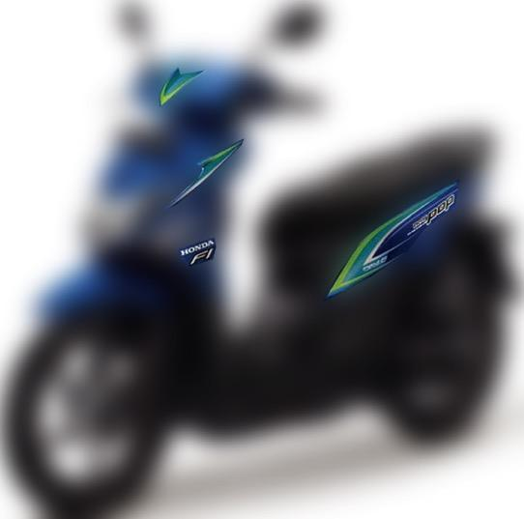
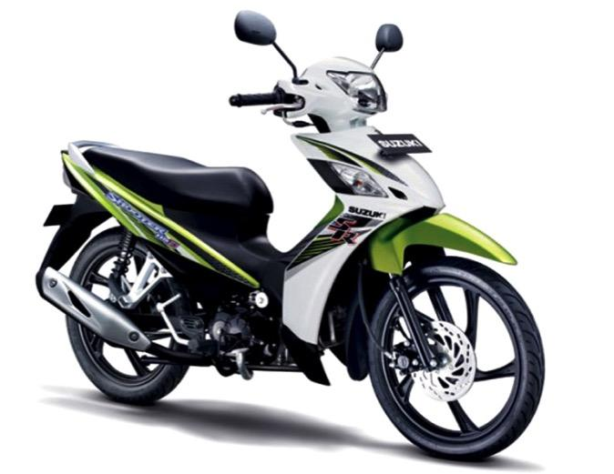
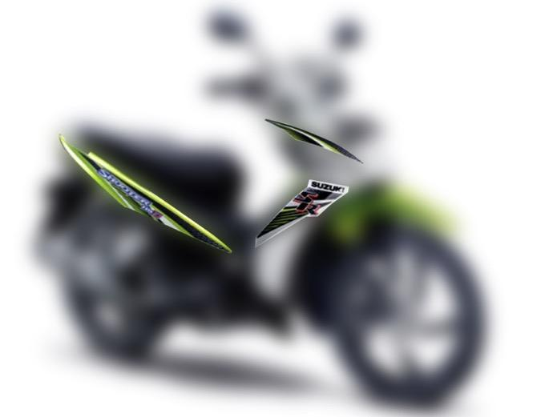
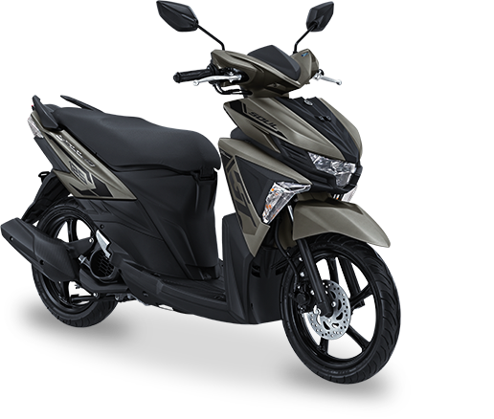
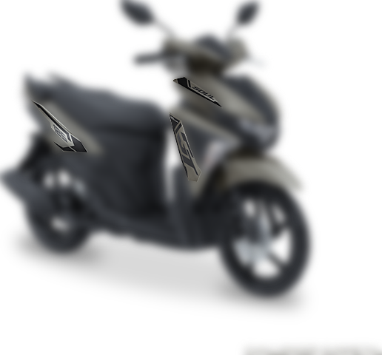
PRODUCTS
Graphics that define the vehicle
OEM automotive graphic applications
Body graphics
Visual identity
Integrated details
GRAFINDO / COMPANY PROFILE 2026
PRODUCTS
09
Notes:
Source: original Grafindo ComPro 2026, slide(s) 7.
One click reveals the original graphic-application highlight images together. The source fade animation sequence and timing are retained.

Slide 10


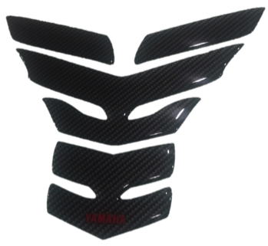

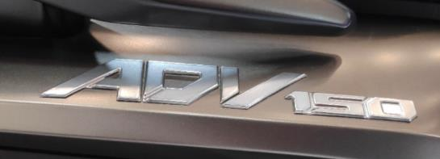
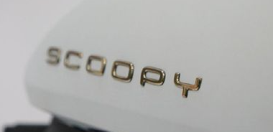


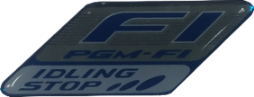
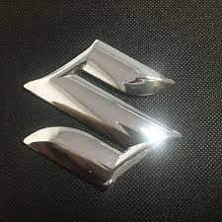
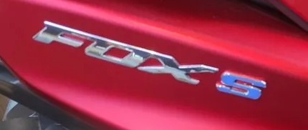
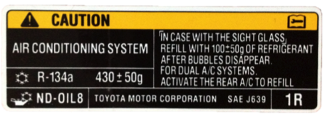

PRODUCTS
Three product platforms
Graphics, dimensional finishes and soft emblems for automotive applications
Graphic & label
Resin dome graphic
Grafindo Soft Emblem
Pressure-sensitive adhesive stickers
Coated for durability
Automotive applications
Pressure-sensitive adhesive stickers
Mercury-free, high-durability resin
Dimensional 3D effect
Flexible 3D emblems
Color and gloss options
Brushed chrome appearance
RoHS · GADSL · REACH SVHC
RoHS · GADSL · REACH SVHC
RoHS · GADSL · REACH SVHC
GRAFINDO / COMPANY PROFILE 2026
PRODUCTS
10
Notes:
Source: original Grafindo ComPro 2026, slide(s) 8.
Product descriptions and RoHS, GADSL, REACH SVHC compliance statements are carried over from the source deck.

Slide 11
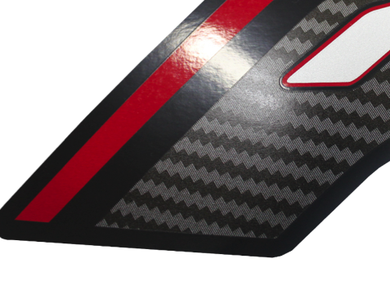
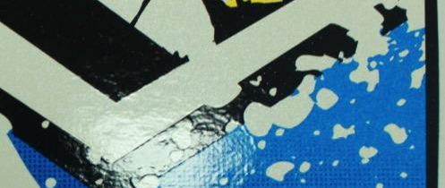
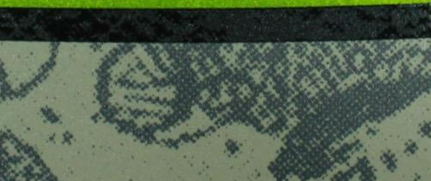
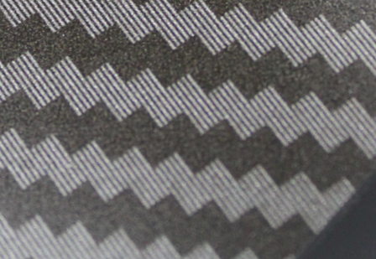
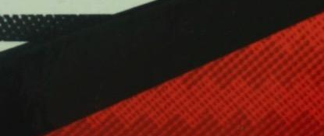

SCREEN PRINTING
Texture, detail & visual depth
Pattern capabilities
Ink splatter
Smokey pattern
High-detail
patterns
Gradation
Multi-gradation
GRAFINDO / COMPANY PROFILE 2026
SCREEN PRINTING
11
Notes:
Source: original Grafindo ComPro 2026, slide(s) 9.

Slide 12
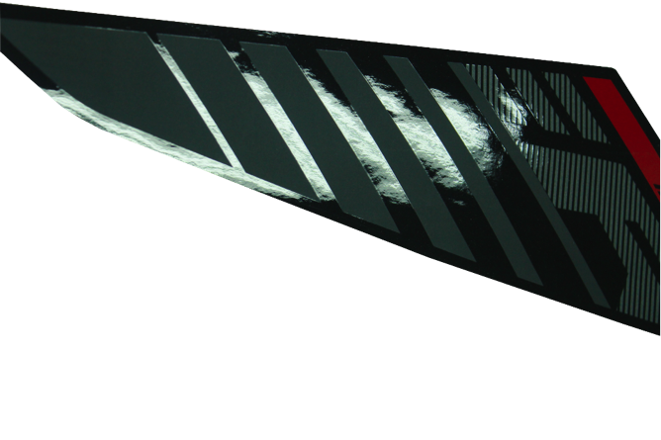
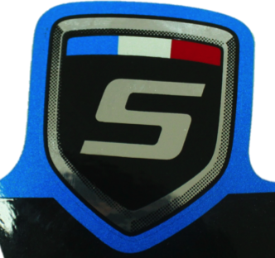
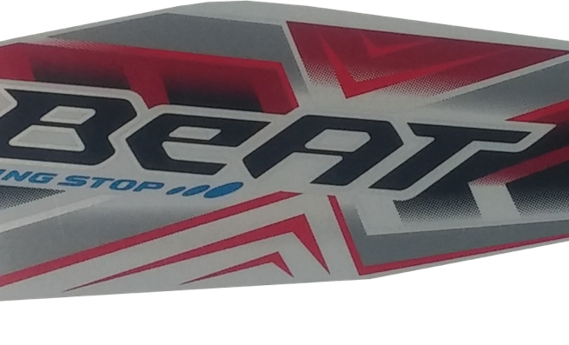
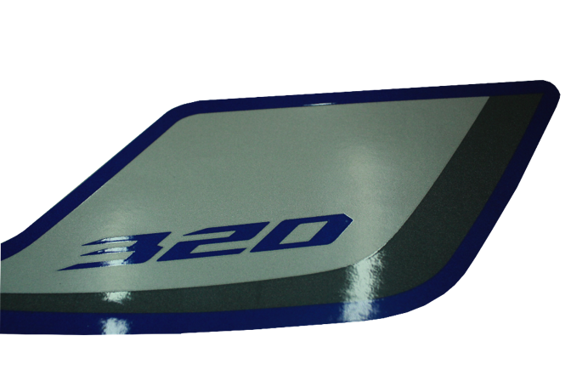
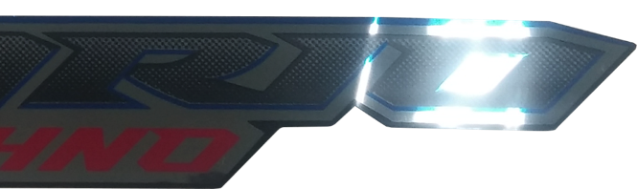
SCREEN PRINTING
Color & surface finishes
Gloss, matte, metallic and chrome effects
Gloss & matte
Solid & metallic
Chrome
GRAFINDO / COMPANY PROFILE 2026
SCREEN PRINTING
12
Notes:
Source: original Grafindo ComPro 2026, slide(s) 10.

Slide 13
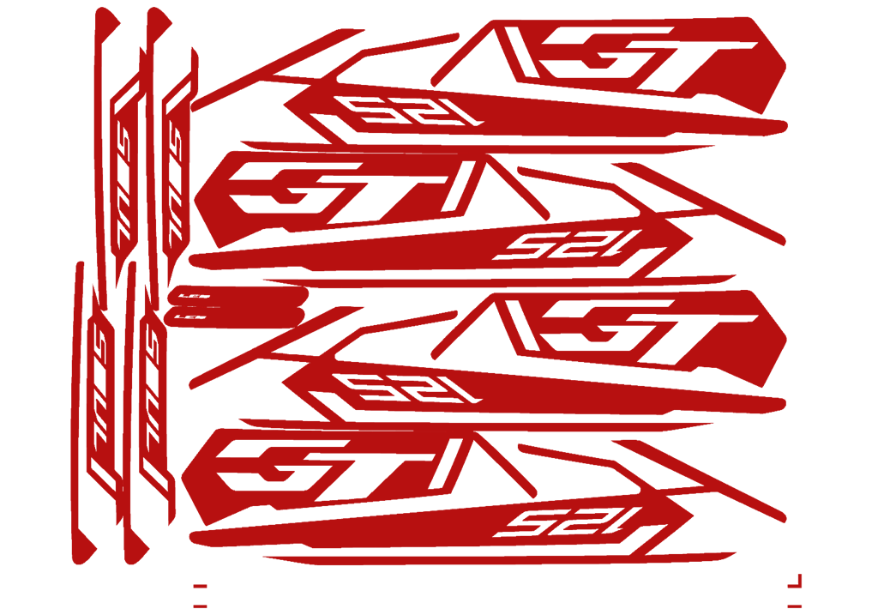



SCREEN PRINTING
Color built, layer by layer
Top view and cross-section • Up to 10 colors
TOP VIEW
SIDE VIEW
6
5
4
3
2
1
1
Vinyl substrate
2
1st color
3
2nd color
4
3rd color
5
4th color
UP TO 10 COLORS
6
Clear coat / dome
Multicolor capability · Vibrant contrast · Profile accuracy · Solid, transparent & metallic colors · Outdoor durability
GRAFINDO / COMPANY PROFILE 2026
SCREEN PRINTING
13
Notes:
Source: original Grafindo ComPro 2026, slide(s) 11.
Six clicks build four ink colors, then the clear-coat/dome finish, then the benefit strip. The original animation timing is preserved and retargeted to the redesigned editable cross-section. Original artwork is retained, with the four color images registered in a gray/white/black/red build.

Slide 14
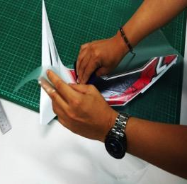
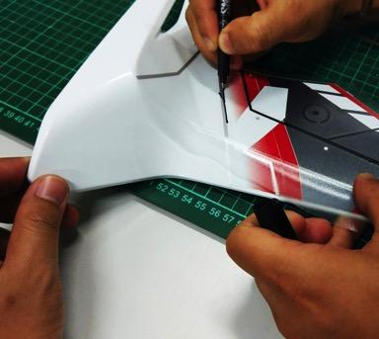
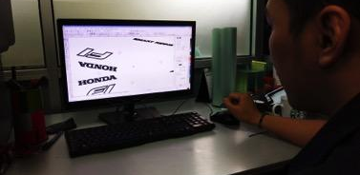
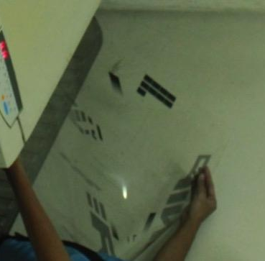
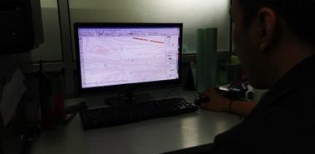
SCREEN PRINTING FLOW
From concept to production
01 / 03 · Design & prepress
01
02
03
04
Drawing / mock-up
Tracing
Digital artwork
Image setting
GRAFINDO / COMPANY PROFILE 2026
SCREEN PRINTING FLOW
14
Notes:
Source: original Grafindo ComPro 2026, slide(s) 12.

Slide 15
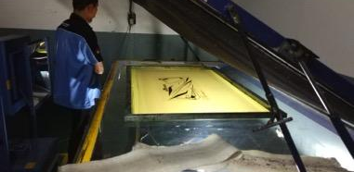
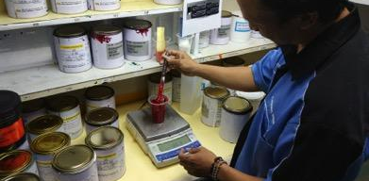
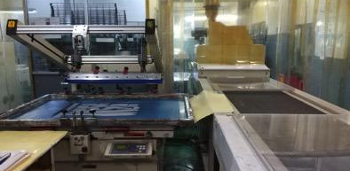
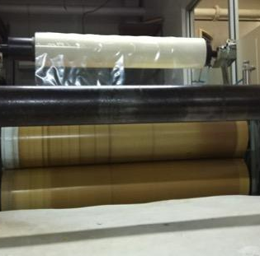
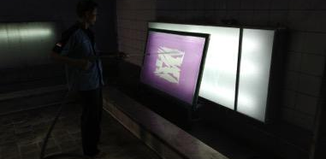
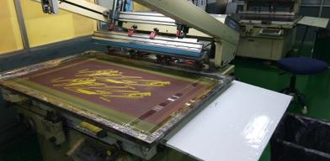
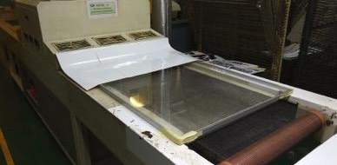
SCREEN PRINTING FLOW
From screen to finished surface
02 / 03 · Printing & finishing
05
06
07
08
Exposure
Color mix & print
Coating / laminating
Premasking
GRAFINDO / COMPANY PROFILE 2026
SCREEN PRINTING FLOW
15
Notes:
Source: original Grafindo ComPro 2026, slide(s) 13.

Slide 16
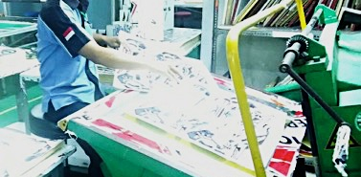
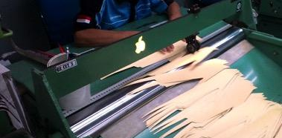
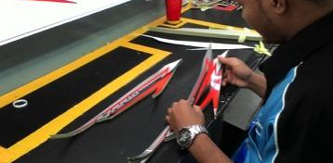
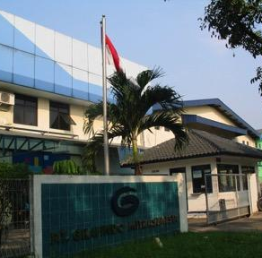
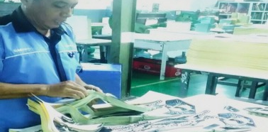
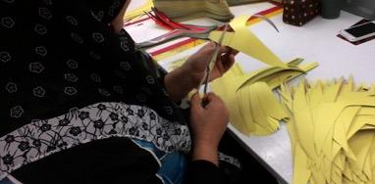

SCREEN PRINTING FLOW
From cutting to customer delivery
03 / 03 · Conversion & logistics
09
10
11
12
Die-cutting
Score-cutting
Packaging
Delivery
GRAFINDO / COMPANY PROFILE 2026
SCREEN PRINTING FLOW
16
Notes:
Source: original Grafindo ComPro 2026, slide(s) 14.

Slide 17

GRAFINDO SOFT EMBLEM
A dimensional identity, formed with precision
High-frequency molding of soft thermoplastic materials
GSE TECHNOLOGY
PVC or PU film constructions, including metal vapor deposition, are formed using high-frequency induction heating.
The molding technique retains the material’s bright metallic appearance.
GRAFINDO / COMPANY PROFILE 2026
GRAFINDO SOFT EMBLEM
17
Notes:
Source: original Grafindo ComPro 2026, slide(s) 15.

Slide 18
GRAFINDO SOFT EMBLEM
GSE layer configuration
Aesthetic, filler and adhesive functions
LAYER STACK
#
Layer
Material
Thickness
1
Protection film
Acrylic
75 µm
1
2
2
Bonding layer
Acrylic adhesive
5 µm
3
3
Metallized layer
Metal
≤ 0.1 µm
4
4
Bonding layer
Acrylic adhesive
5 µm
5
5
Film
ABS
395 µm
6
6
Film
PVC
Customizable
7
7
Double-sided adhesive
Acrylic base
100–320 µm
01–05 Aesthetic function
06 Filler function
07 Adhesive function
FINISH OPTIONS
Gloss or matte · Pigmented colors such as gold and red
Brushed metallized layer for a hairline appearance
GRAFINDO / COMPANY PROFILE 2026
GRAFINDO SOFT EMBLEM
18
Notes:
Source: original Grafindo ComPro 2026, slide(s) 16.
The original EMF table has been transcribed into editable native text and shapes. Thicknesses are unchanged. Layer 1 offers gloss/matte appearances; layer 2 can be pigmented (e.g. gold and red); layer 3 can be brushed for hairlines. The layer-stack schematic is illustrative and not to scale.

Slide 19
GRAFINDO SOFT EMBLEM
Design boundaries for reliable production
X = emblem thickness, excluding adhesive
01
02
03
Element spacing
N
Element width
Emblem thickness
A
B
1.1–2.5
X + 0.5 mm
mm
Minimum: X
Preferred: X + 0.5 mm
Minimum: X
Preferred: X + 0.5 mm
Emblem only, without adhesive.
Between separate elements,
including letters in a string.
Suggested minimum width
of a single element.
Wider parts can support greater
thickness. Narrow emblems
should not be made too thick.
GRAFINDO / COMPANY PROFILE 2026
GRAFINDO SOFT EMBLEM
19
Notes:
Source: original Grafindo ComPro 2026, slide(s) 17.

Slide 20

GRAFINDO SOFT EMBLEM
GSE production process
Ten main stages, with final inspection and a repair loop
START
01
02
03
04
Welding
Adhesive
Kiss-cut emblem
Peeling
08
07
06
05
Die-cutting
Masking
Re-layout
Inspection 1
RE-INSPECTION
Production floor
9a
10
9b
Final inspection
Packing
Repair & inspect
Inspection is integrated into
the process, including the
repair stage.
END
REWORK
GRAFINDO / COMPANY PROFILE 2026
GRAFINDO SOFT EMBLEM
20
Notes:
Source: original Grafindo ComPro 2026, slide(s) 18.

Slide 21

GRAFINDO SOFT EMBLEM
Profiles in mass production
OEM soft-emblem applications already in production
SCOOPY
ADV
FOX POLYTRON
GRAFINDO / COMPANY PROFILE 2026
GRAFINDO SOFT EMBLEM
21
Notes:
Source: original Grafindo ComPro 2026, slide(s) 19.

Slide 22




EQUIPMENT
Capacity, flexibility & validation
Design development • Printing • Evaluation
Design development
Printing equipment
Evaluation
SUGA SX75
Xenon-arc weatherability testing
Complies with YGK standard
Extreme testing in a shorter period
Full auto (5 unit)
Semi-auto (19 unit)
In-house artwork & film design
Design confidentiality
Flexible design changes
1,000,000
sets / year · Total printing capacity
Accuracy and flexibility for multiple variants
GRAFINDO / COMPANY PROFILE 2026
EQUIPMENT
22
Notes:
Source: original Grafindo ComPro 2026, slide(s) 20.

Slide 23




EQUIPMENT
Dome & soft-emblem production
Dedicated machines for dimensional graphics and emblems
Resin dome
Grafindo Soft Emblem
Mercury-free system · Degassing to minimize bubbles
RP12 (1 unit)
RP15 (2 unit)
Three machines · RP12 and RP15
6,000,000
5,000,000
pcs / year
pcs / year
GRAFINDO / COMPANY PROFILE 2026
EQUIPMENT
23
Notes:
Source: original Grafindo ComPro 2026, slide(s) 21.

Slide 24






MATERIALS
Customer
Our Customer
Yamaha
Astra Honda Motor
TVS
Suzuki
Denso
Polytron
GRAFINDO / COMPANY PROFILE 2026
MATERIALS
24
Notes:
Source: original Grafindo ComPro 2026, slide(s) 22.

Slide 25






MATERIALS
Established global material suppliers
Materials sourced from Japan, Italy, Germany and Switzerland
Lintec Co.
Seiko Advance Co.
Teikoku Printing Inks Mfg. Co.
JAPAN
JAPAN
JAPAN
Color-Dec
Kissel + Wolf GmbH
Sefar AG
ITALY
GERMANY
SWITZERLAND
GRAFINDO / COMPANY PROFILE 2026
MATERIALS
24
Notes:
Source: original Grafindo ComPro 2026, slide(s) 22.

Slide 26
PT. GRAFINDO
MITRASEMESTA
Thank you.
HEAD OFFICE & WORKSHOP
Cikarang Industrial Estate · Jababeka I
Blocks U8D, U8C & U7A
Cikarang, Bekasi, Indonesia
admin1@grafindomitrasemesta.com
www.grafindomitrasemesta.com
Tel. 8934714–16 · 8935120 · 89110628–29 · 89111014–15
Fax 8934713 / 89111016
Notes:
Source: original Grafindo ComPro 2026, slide(s) 5, 23.
Contact details reproduced from the contact image on source slide 5. Thank-you message from source slide 23.

